Slide 1
Factors Affecting Liveability

Slide 2
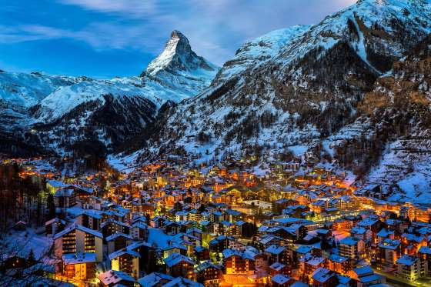
Human & Environmental
Liveability varies from place to place, and can be influenced by human and environmental factors
Human factors are ones that we as people can influence, like crime, arts, transport, and cultural elements
Environmental factors are natural ones that affect living in an area, like rainfall, temperature and terrain
Zermatt, Switzerland
Notes:
Human: crime will affect who chooses to live in the area, what businesses are attracted to it, house prices and how safe people feel on the streets
Natural: flooding, drought/access to water, heat waves, freezing temperatures, mountainous/hard to access areas

Slide 3
Environmental Factors

Slide 4
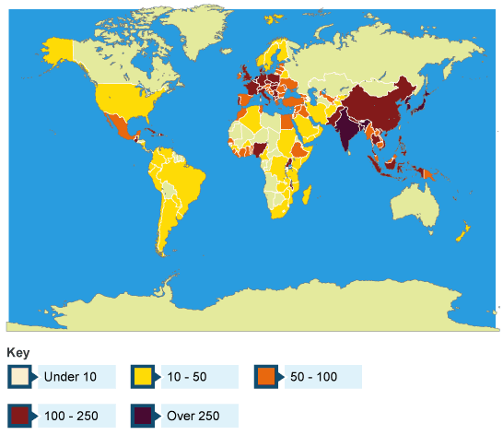
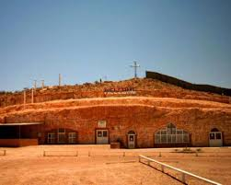
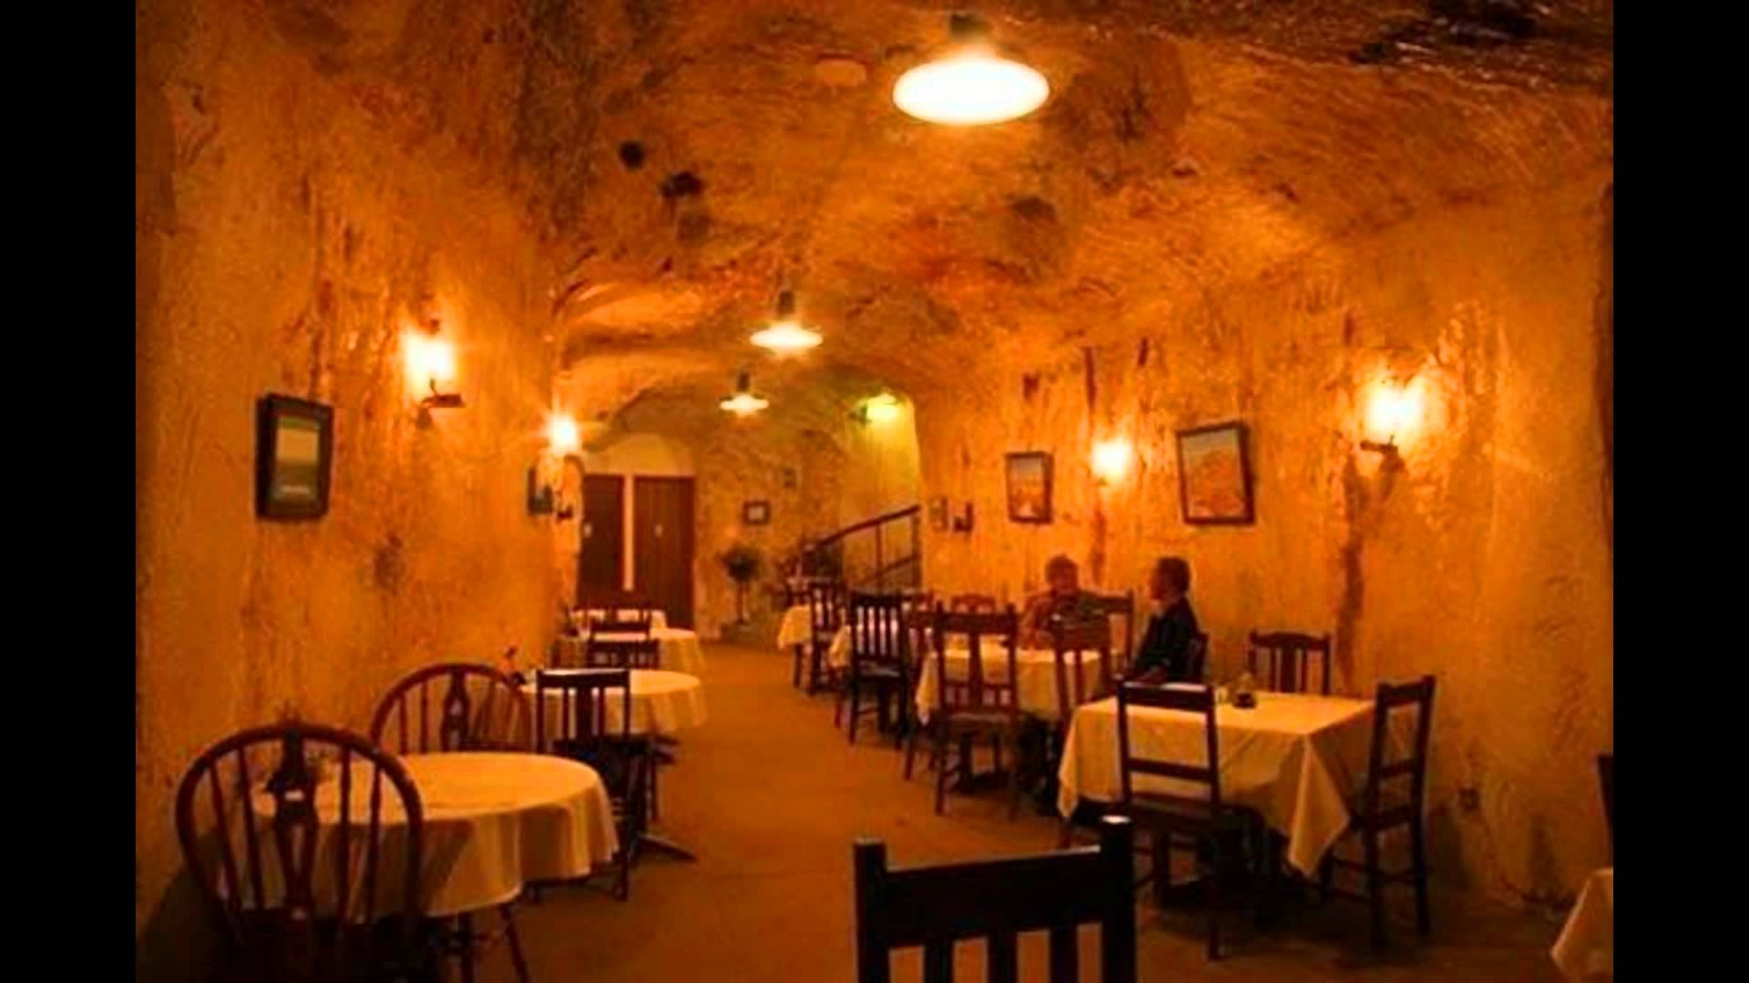
Climate
The majority of humanity live within a fairly narrow range of latitude, as the climate here is generally warm, stable, and allows things to be grown
Approximately 40% of the world’s population live near coasts
85% of Australia’s population live near the coast
People who live in harsh climates often have to adapt certain practices in order to make their lives sustainable
Number of people living per square kilometer
Coober Pedy, SA

Slide 5
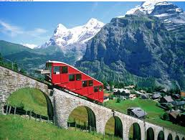
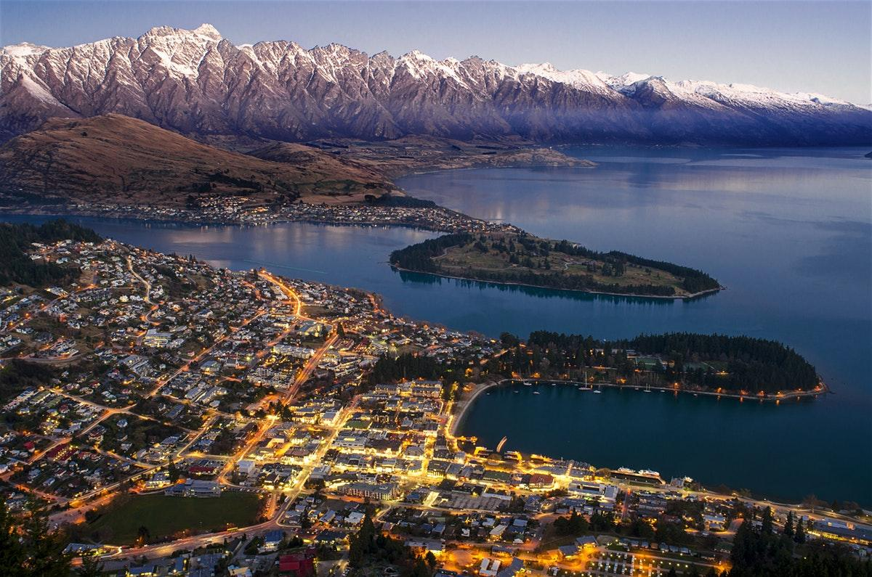
Landforms
Landforms can affect the liveability of areas by making transportation and movement difficult
Some landforms can be seen as a major asset and draw card to increase the liveability of a place, as they provide major aesthetic value and recreational activities.
Parts of Switzerland are only accessible by cable car
Queenstown, NZ

Slide 6
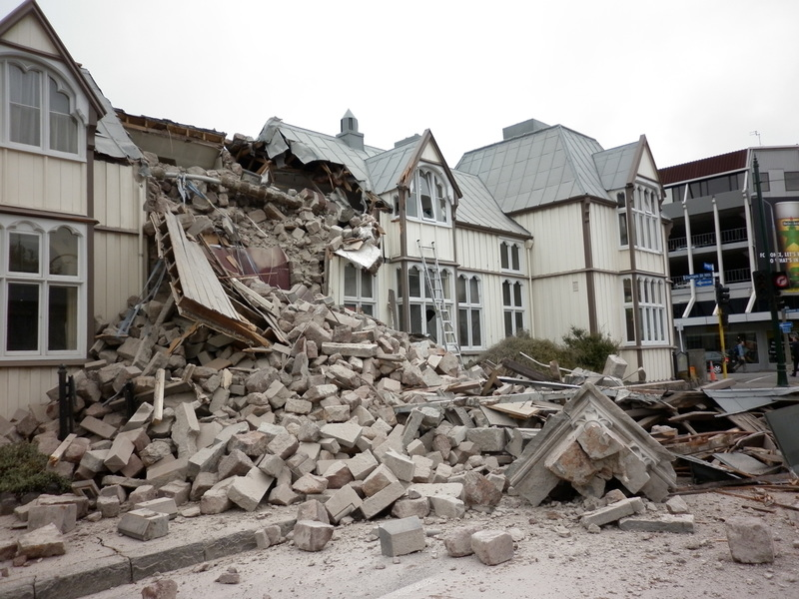
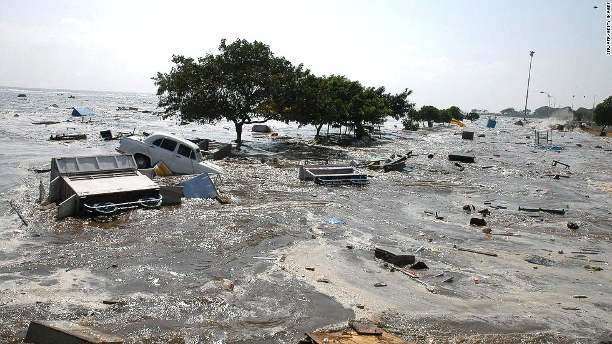
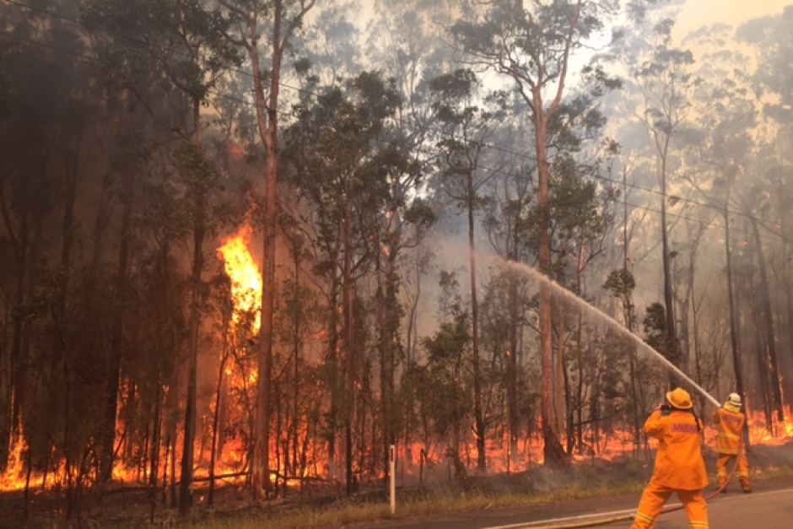
Natural Hazards
Natural hazards can make living in some places extremely dangerous and unpleasant
They can affect house prices, insurance costs, and seriously affect people’s decision to live in a particular area
Christchurch Earthquake
Boxing Day Tsunami
NSW Bushfires

Slide 7
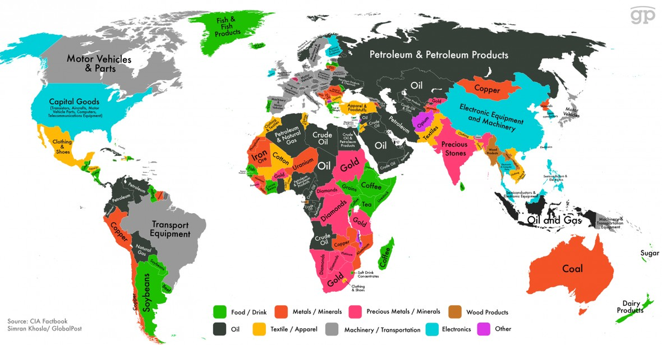
Natural Resources
Close access to natural resources like water and food are essential, and are not fairly distributed around the world
Access to fresh water, even regular sunlight, can affect how liveable an area is, especially now that renewable energy is becoming increasingly commonplace.
Living far away from natural resources, especially essential ones like drinking water, can make living in remote parts of the world very challenging.

Slide 8


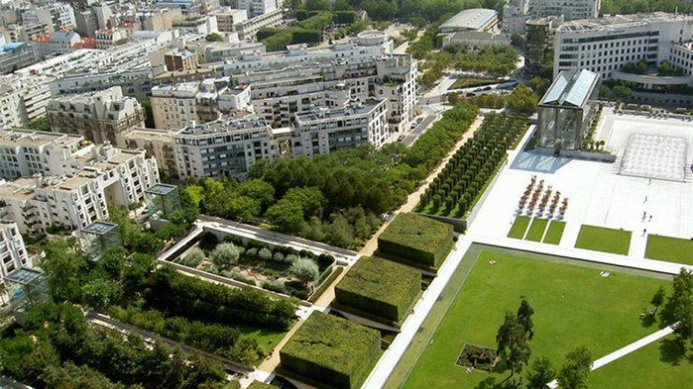
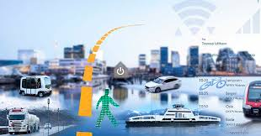
Human Factors

Slide 9


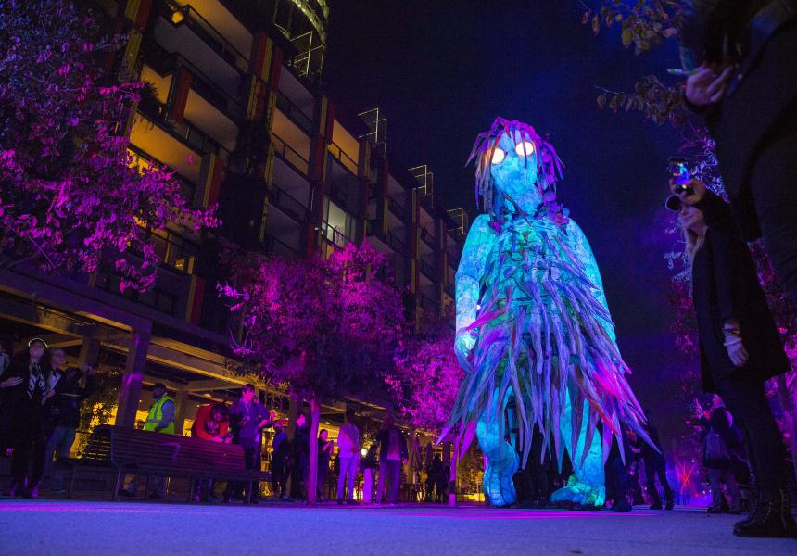
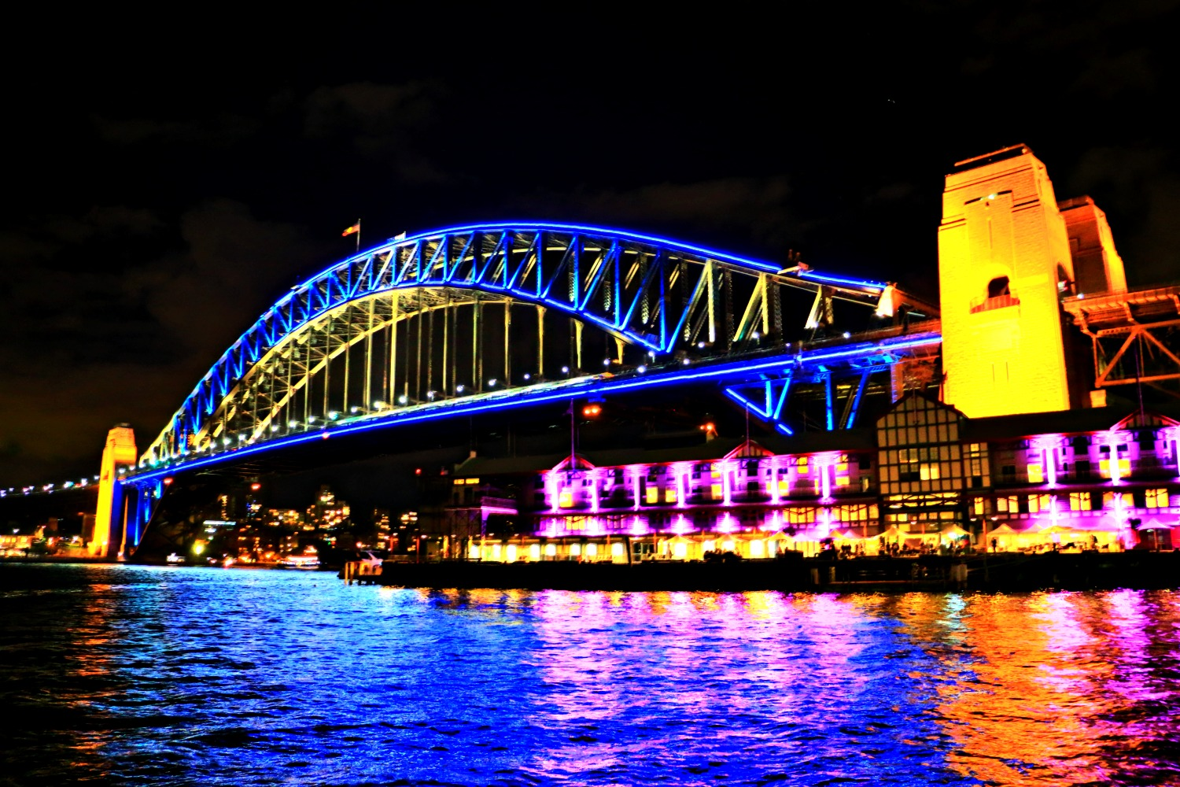
Culture
Culture is a very broad concept that includes a range of human creative and intellectual activities and ideas.
The culture of an area can be seen in its art, food, museums
Major cities are often considered more liveable due to their large cultural scenes, with shows and events that would not usually be seen in smaller, less densely populated areas.

Slide 10
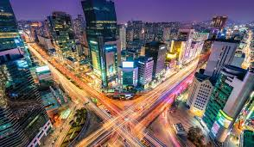

Employment
The availability of jobs varies from city to city, and especially from region to region
There are higher concentrations of people in cities, which means you are more likely to find a place to work that suits you
Cities also offer more networking opportunities

Slide 11



Crime and Safety
Crime and safety is a very significant factor when considering where to live
People with young families are less likely to buy in high crime areas
Contrary to popular belief however, in Sydney it does not affect house prices
Caracas in Venezuela has the highest murder rate in the world, of 120 deaths per 100,000 people compared to Sydney’s of 1.0 per 100,000
Notes:
Source of house prices: https://www.news.com.au/finance/real-estate/sydney-nsw/prices-in-suburbs-with-high-rates-of-dangerous-crime-outperformed-rest-of-sydney/news-story/d05cba6e0079972d5425776d0a1a0997

Slide 12
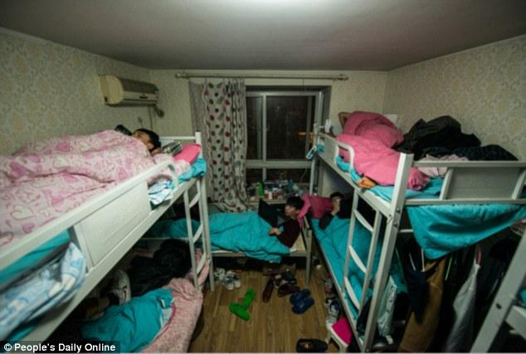
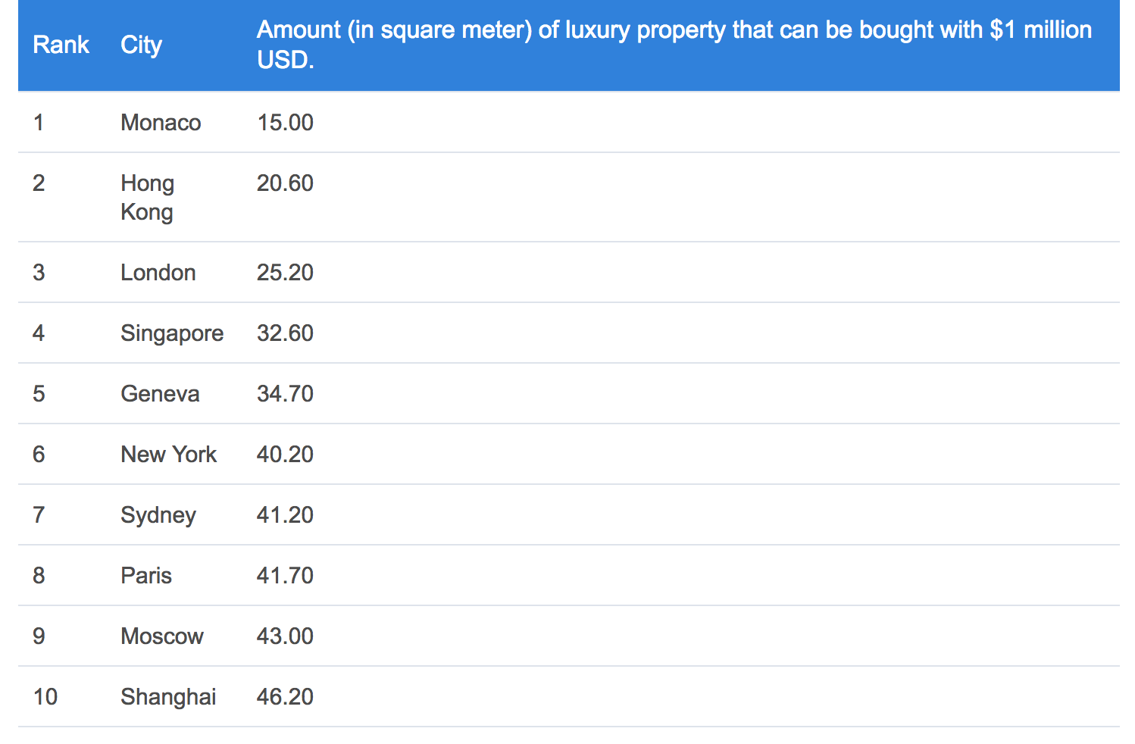
Shelter
Being able to afford and access shelter is a human necessity and right
Some cities have more affordable shelter than others
Often students and the poor are forced to live in less desirable situations
Sydney is less affordable than many other major cities
Room sharing for workers in China

Slide 13
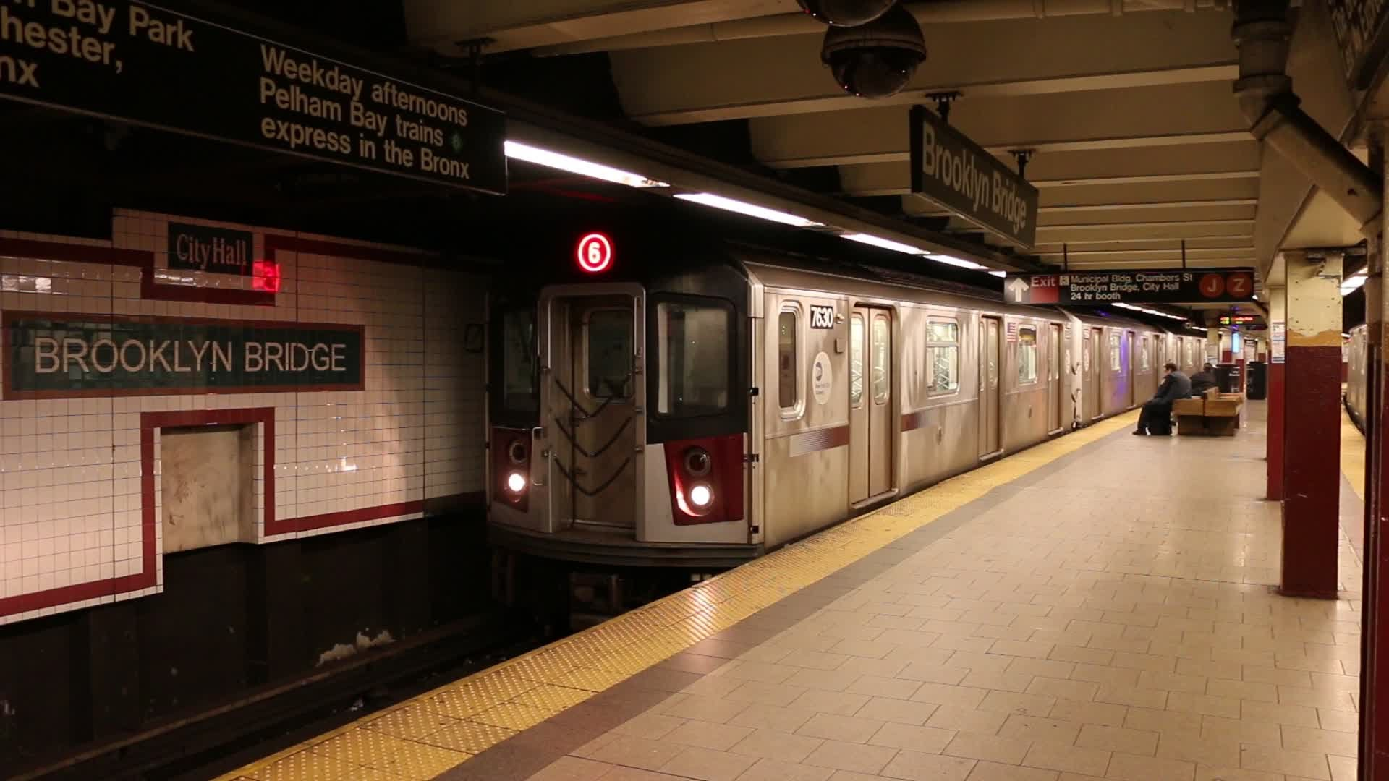
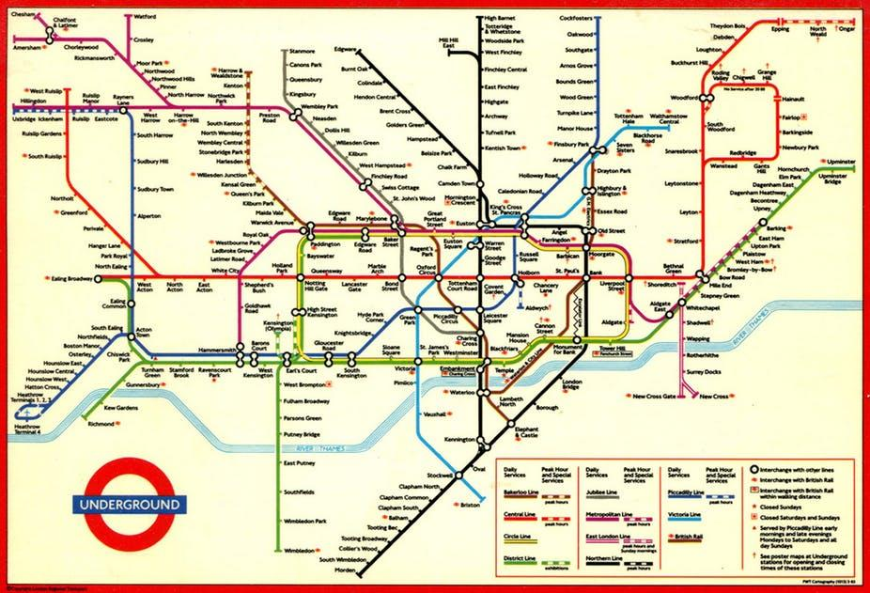
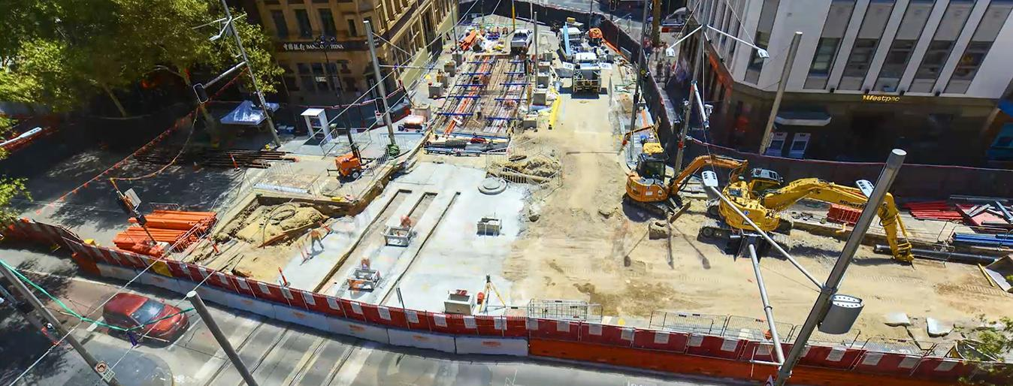
Transport
Transport infrastructure can make some cities far more easy to navigate and liveable than others
Megacities like London, New York and Tokyo have very efficient subways
The Sydney CBD is currently undergoing extensive construction to put in a light rail and improve the transportation in the congested centre

